Slide 1
PROJECT 2
Database Concepts
Spring 2017
Week 13

Slide 2
Requirement for Project #2
60 pts.
ERD (connectivities, cardinalities, PKs, FKs, relationship participation) (30pts)
Specialization hierarchy (Subtype discriminator, disjoint/overlapping constraint, total/partial constraint) (5 pts)
Be able to forward-engineer (15 pts)
Each table (except the entity subtype) must include five records
Number of record in entity subtype depends on data values in entity supertype
20 pts.
Data dictionary as a Excel spreadsheet file
20 pts.
SQL queries and query result sets
SQL statements and their query results sets using SSH terminal (Notes→MySQL Workbench and SSH Login→FSU_CCI_MySQL_SSH_Login_MAC/PC.pdf)

Slide 3
Requirement
Extra credit (15 pts)
Additional data records (five more records per entity except subtype entity)
Peer evaluation (no need to submit if you choose to work individually)
Submit your .zip file (includes mwb, excel, word document) via project 2 submission link on Blackboard by April. 30 (11:59 pm)
Group link: https://docs.google.com/spreadsheets/d/1NxseqZlX0gT6SNulZUAamY2fzUR54IM5RInUgw9r8VY/edit?usp=sharing
Each group only needs to submit one copy

Slide 4
Extra credit (15 pts)
Additional data records (five more records per entity except subtype entity)
Peer evaluation (no need to submit if you choose to work individually)
Submit your .zip file (includes mwb, excel, word document) via project 2 submission link on Blackboard by April. 30 (11:59 pm)
Each group only needs to submit one copy

Slide 5
Business rules
A department employs many employees, and each employee may be employed by one department.
Some employees, known as “rovers,” are not assigned to any department.
An employee must be either a full time or a part time employee.
An employee cannot be both a full time and a part time employee.
A division operates many departments, and each department is operated by one division.
An employee may be assigned many projects, and a project may have many employees assigned to it.
A project must have at least one employee assigned to it.
One of the employees manages each department, and each department is managed by only one employee.
One of the employees runs each division, and each division is run by only one employee.
Notes:
Department employs Employee relationship: One-to-Many relationship. Department is optional in this relationship.
Division operates Department relationship: one-to-Many relationship. Both entities are mandatory in this relationship.
Employee has Project relationship: Many-to-Many relationship. Need to create an associative entity (called assignment) to split it to two one-to-many relationship.
Employee has Assignment relationship: One-to-Many relationship. Assignment is optional in this relationship.
Project has Assignment relationship: One-to-Many relationship. Both entities are mandatory in this relationship.
Employee manages Department relationship: One-to-One relationship. Department is optional in this relationship.
Employee runs Division relationship: One-to-One relationship. Division is optional in this relationship.

Slide 6
Required attributes
Department: name, street, city, state, zip, phone, email, note
Employee: first name, last name, type, street, city, state, zip, phone, email, note
Part_time: hourly rate, max hour per week
Full_time: Anual salary
Division: name, street, city, state, zip, phone, email, url, note
Assignment: name, start_date, end_date, duration, evaluation, note
Project: name, note

Slide 7
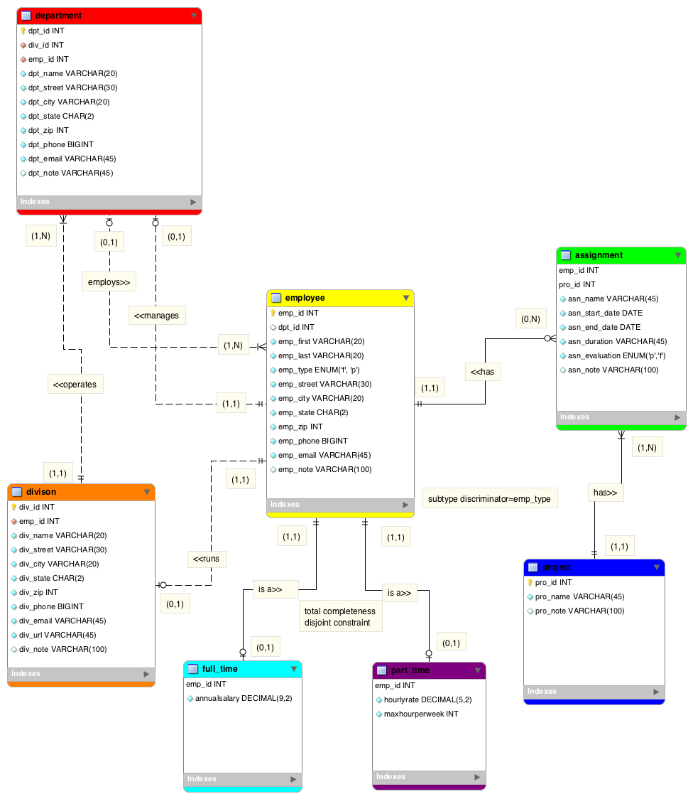
Notes:
Department employs Employee relationship: One-to-Many relationship. Department is optional in this relationship.
Division operates Department relationship: one-to-Many relationship. Both entities are mandatory in this relationship.
Employee has Project relationship: Many-to-Many relationship. Need to create an associative entity (called assignment) to split it to two one-to-many relationship.
Employee has Assignment relationship: One-to-Many relationship. Assignment is optional in this relationship.
Project has Assignment relationship: One-to-Many relationship. Both entities are mandatory in this relationship.
Employee manages Department relationship: One-to-One relationship. Department is optional in this relationship.
Employee runs Division relationship: One-to-One relationship. Division is optional in this relationship.

Slide 8
Forward Engineering

Slide 9
Forward Engineering
Cut

Slide 10
Forward Engineering
Paste

Slide 11
Data dictionary
Data dictionary: Description of all tables in the database
created by the user and designer
“the database designer’s database” : it records the design decisions about tables and their structures.
Reference page #89

Slide 12
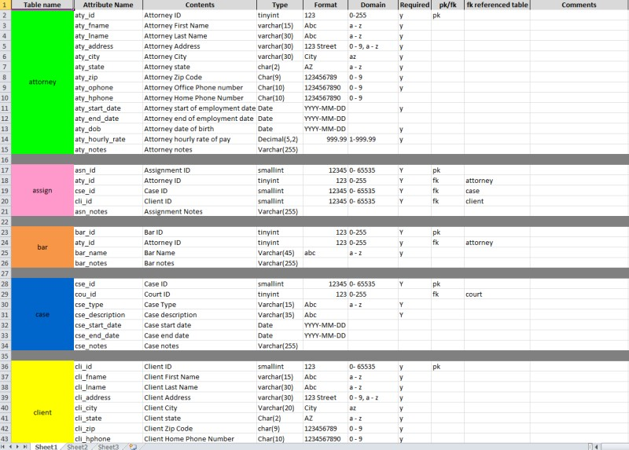

Slide 13
Data type ranges
Reference
- http://dev.mysql.com/doc/refman/5.0/en/integer-types.html

Slide 14
Four SQL statement questions
Use NATURAL JOIN
Use GROUP BY
Use HAVING clause
Use two SQL Built-in functions in a single statement

Slide 15
Natural Join
List attributes from employee and assignment;
List attributes from assignment and project;
List attributes from employee and full_time;
List attributes from employee and part_time;

Slide 16
Group By
Only used when in conjunction with one of the SQL aggregate functions (COUNT, MIN, MAX, AVG, and SUM) in the SELECT statement
SQL execution sequence
SELECT columnlist
FROM tablelist
[GROUP BY columnlist];
Choose the attributes which contain numerical data value to work with!

Slide 17
Having
Extension of GROUP BY feature
Applied to output of GROUP BY operation
Used in conjunction with GROUP BY clause in second SQL command set
Similar to WHERE clause in SELECT statement
SQL execution sequence
SELECT columnlist
FROM tablelist
[GROUP BY columnlist]
[HAVING conditionlist]
[ORDER BY columnlist [ASC | DESC]];

Slide 18
Two SQL Built-in functions
Select format (avg(),decimal place) from…;
Select format (max(),decimal place) from…;
Select round (avg(),decimal place) from…;
Select round (max(),decimal place) from…;
…

